Slide 1
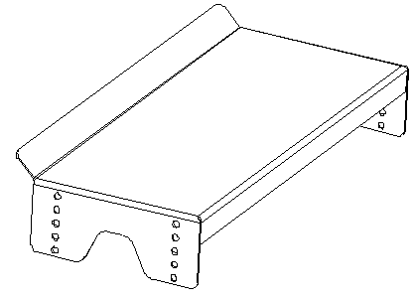
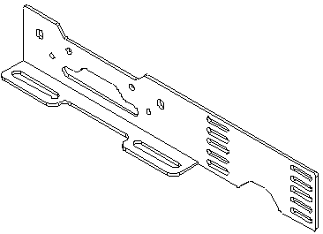
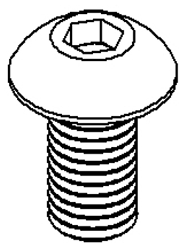

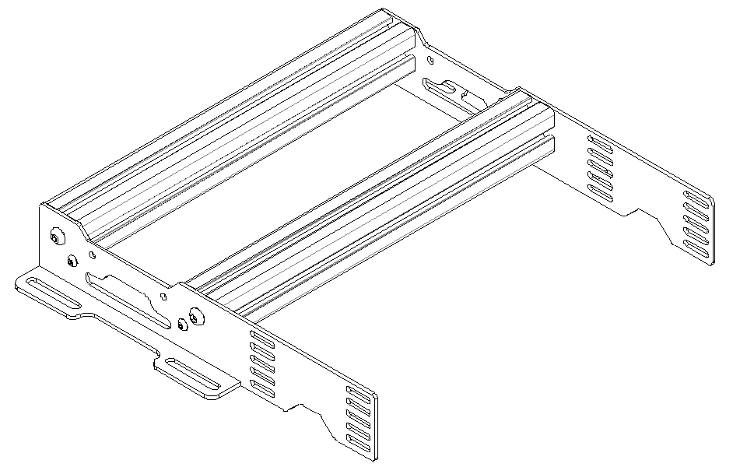

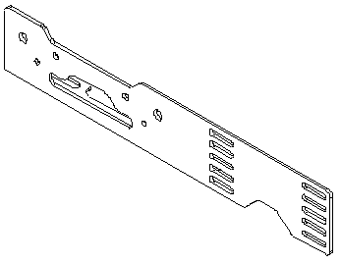
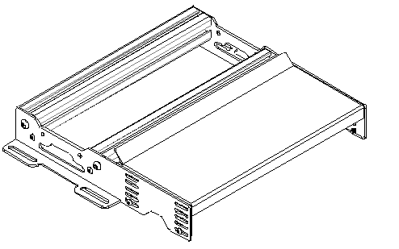
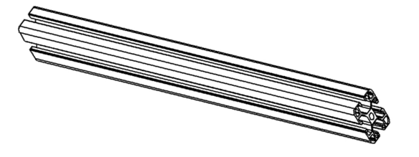
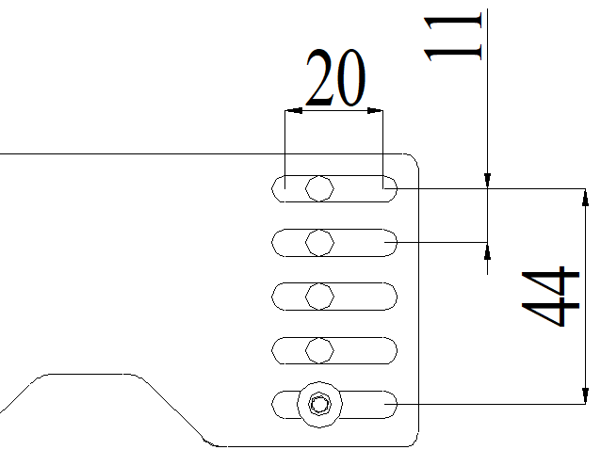
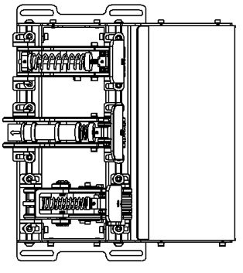

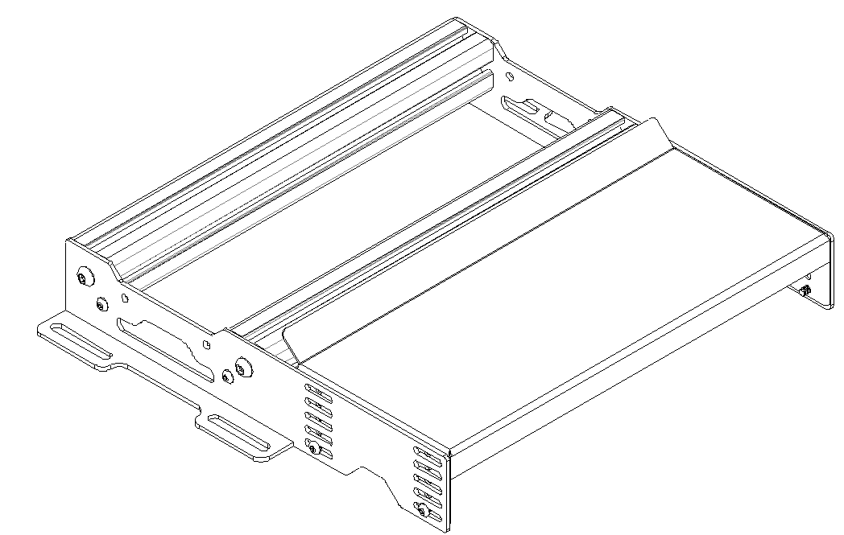


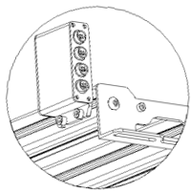
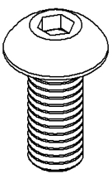




VNM PEDAL HEEL REST
Quick Guide
Content
Set up
1
2
M8x20
Step 1: Mounting Heel Rest Holders:
Install the heel rest holders on the aluminum profiles
4
3
x2
1. Face Plate
2. Left Heel Rest Holder
3. Right Heel Rest Holder
4. Aluminum Profiles
M5x8
Step 2: Mounting Face Plate:
Choose the most comfortable height or recline for your seating position
Then tighten the bolts with the included nuts and washers
Set up with VNM Pedal Set
The Control box can be installed on the back of pedal heel rest. Install by M6 scew and T nut with profile 4040 aluninum bar.
M6x16
M6x16
Install your pedal units to the aluminum profile. Tighten the bolts with the included T nuts and washers
M5x12

Slide 2
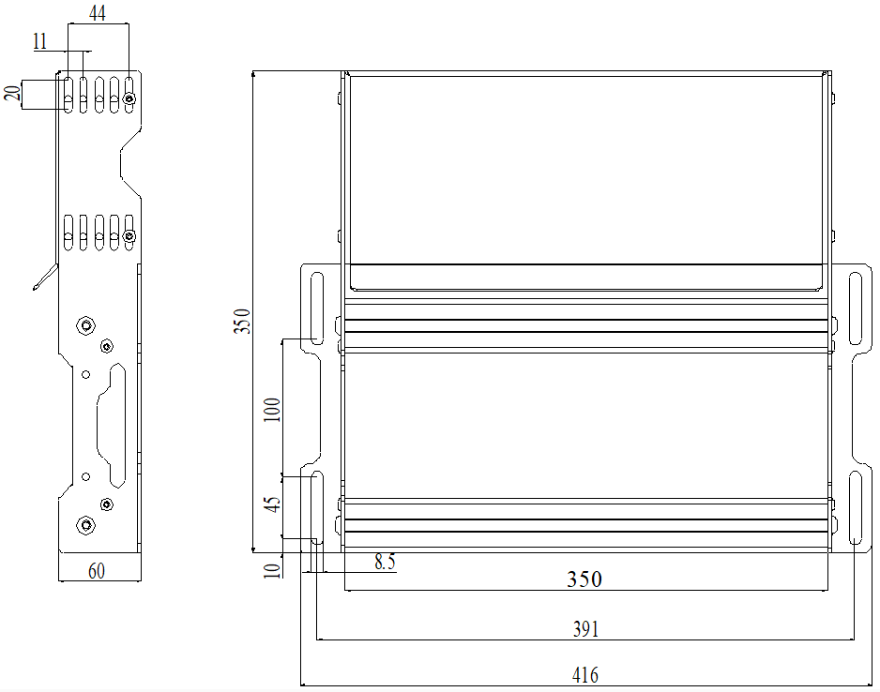
Mounting Drawing

